Slide 1
Predicting Cardiovascular Disease Using the Factors of Poverty
Elliot Ting

Slide 2
The Problem
Compared to the average of other countries with comparable incomes, healthcare costs in the US exceed the average by a multiple of 3. (Source: Organization for Economic Co-operation and Development)
The US spends more on healthcare than any other country, but has middling health outcomes.
30th in the world in terms of life expectancy (Source: World Health Organization)

Slide 3
The Question to Answer
Can we predict cardiovascular mortality rates in the United States using the factors of poverty?

Slide 4
Why is this important?
According to the American Health Association, Cardiovascular Disease costs are projected to exceed $1 Trillion by 2035.
If we can accurately predict the Cardiovascular mortality rates using these factors, then we can focus our limited resources on one general theme rather than multiple themes.

Slide 5
Why is this project of limited scope?
The realities of the US political climate.
Other common sense factors (Education, Health Insurance Coverage) currently encounter heavy partisan bickering.
Luckily, reducing poverty still has bipartisan support.
We could use the limited political capital on reducing poverty instead of fighting.

Slide 6
Master Dataset
Combination of :
US Census Poverty Rates 1980-2016
Information and Accountability Transparency Dataset
Bureau of Economic Analysis US GDP 1980-2017
Overall US Labour Productivity 1970-2016 from the Bureau of Labor Statistics
Average Annual Unemployment Rates by State from the US Bureau of Labor Statistics
University of Washington’s Institute for Health Metrics and Evaluation Cardiovascular Mortality Rate dataset

Slide 7
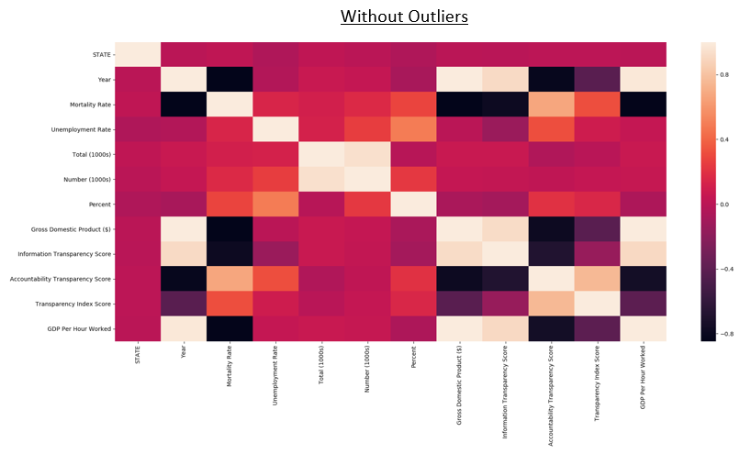
Exploratory Data Analysis – Are there obvious correlations?

Slide 8
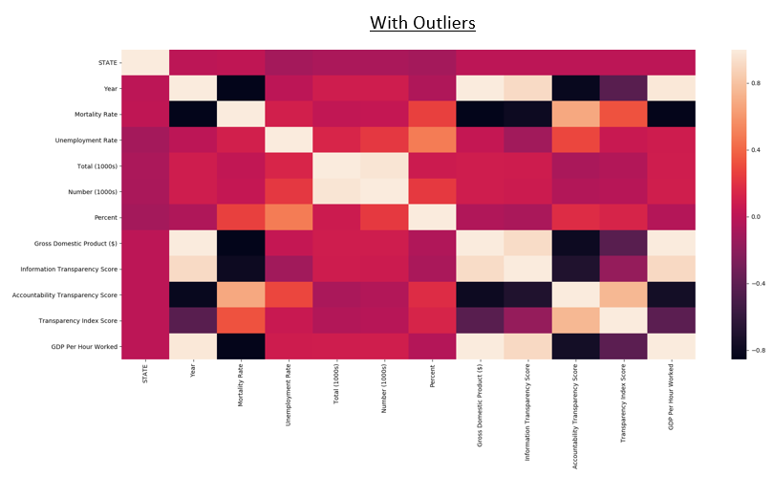
Exploratory Data Analysis – Are there obvious correlations?

Slide 9
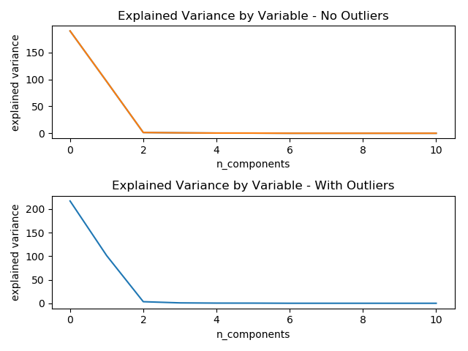
What are the statistically significant variables?

Slide 10
What are the statistically significant variables?
Variable | Explained Variance Ratio – Without Outliers
STATE | 65.74%
Year | 33.26%
Unemployment Rate | 0.48%
Total (1000s) | 0.28%
Number (1000s) | 0.13%
Percent | 0.10%
Gross Domestic Product ($) | 0.01%
Information Transparency Score | 0.01%
Accountability Transparency Score | 0.00%
Transparency Index Score | 0.00%
GDP Per Hour Worked | 0.00%

Slide 11
What are the statistically significant variables?
Variable | Explained Variance Ratio – With Outliers
STATE | 67.19%
Year | 31.29%
Unemployment Rate | 1.03%
Total (1000s) | 0.26%
Number (1000s) | 0.11%
Percent | 0.09%
Gross Domestic Product ($) | 0.01%
Information Transparency Score | 0.01%
Accountability Transparency Score | 0.00%
Transparency Index Score | 0.00%
GDP Per Hour Worked | 0.00%

Slide 12
What are the possible machine learning methods?
Linear Regression
Ordinary Least Squares
Lasso
Elastic Net
Decision Trees Regressions
Regular Decision Tree
Random Forest
AdaBoost

Slide 13
Cross-Validation Technique Used: GroupKFold
Due to the longitudinal nature of our data, we could not rely on a regular k fold technique.
We could have grouped by State or Year. We choose Year.
The GroupKFold variation ensured that the same group would not appear in two different folds.

Slide 14
Variance Explained Linear Regression
Variation | Using All Variables | Using Top 3 Variance Explaining Variables
Least Squares | 0.2482 | 0.6185
Lasso | 0.6811 | 0.6254
Elastic Net | 0.6845 | 0.6434

Slide 15
Variance Explained Decision Trees Regression
Variation | Using All Variables | Using Top 3 Variance Explaining Variables
Regular Decision Tree | 0.4374 | 0.0398
Random Forest | 0.6966 | 0.3446
AdaBoost | 0.6248 | 0.3658

Slide 16
Conclusion
We can use the factors of poverty to predict cardiovascular mortality rates.
With no tweaking of the hyperparameters, we were able to explain 69.66% of the data’s variation with a Random Forest.
Therefore, focusing on improving the factors of poverty will result in a favorable Cardiovascular mortality rate outcome.

Slide 17
Future Work
We could focus on more than just one type of Cardiovascular Disease.
We could incorporate other ‘common sense’ factors of Cardiovascular mortality. (Age, Exercise, Insurance, etc)

